Slide 1
MRT Taxi Secrets
Chan Jia Yi P7337992

Slide 2
Data (Sources)
https://data.gov.sg/dataset/nparks-car-park-lots
https://data.gov.sg/dataset/taxi-availability
https://data.gov.sg/dataset/hdb-carpark-information
https://data.gov.sg/dataset/lta-taxi-stop
https://data.gov.sg/dataset/public-transport-utilisation-average-trip-distance
https://twitter.com
https://here.com
https://mapbox.com
https://github.com/xkjyeah/singapore-postal-codes
https://github.com/xkjyeah/singapore-postal-codes/blob/master/mrt_stations.json
https://github.com/captmomo/mrt_tbc

Slide 3
About the RAW datasets
nparks-car-park-lots-kml.kml
It is converted to json then to csv
Taxi Availability
Json files every minute
Direct insert relevant data (selected fields) into MySQL
hdb-carpark-information.csv
Csv file with 2109 rows and 12 columns
Used directly as markers in maps
lta-taxi-stop-kml.kml
Converted to json then converted to CSV
Used directly as markers in maps
https://twitter.com
To draw out tweets for wordCloud and for MRT breakdown counts by doing a series of cleaning (manually), since tweets comes in all kinds of languages, symbols, capitalizations and have emoticons
buildings.json
Converted to csv then uploaded to MySQL
Retrieved for address, long, lat and postal codes for the Maps
mrt_stations.json
Converted to csv then used in Map and calculator and bar graph, boxplot
public-transport-utilisation-average-trip-distance.csv
Uploaded into MongoDB for easy retrieval
Used in scatterplot
https://github.com/captmomo/mrt_tbc
Added on to the scrapped data (older data) from this website by crawling more on Twitter Api. Then I manually cleaned more data for MRT breakdown before processing it
Have no access to his codes on calculations, and my codes are done in Python while his is R program. My codes are written from fresh

Slide 4

What are singaporeans thinking of?
First of all , to get the general census, I did a twitter API to get tweets
Take only the root of the words
Remove Emoticons
Since output of the words are still weird words, I went to narrow down to some topics Singaporeans might be interested about
Build a wordcloud in Jupyter

Slide 5
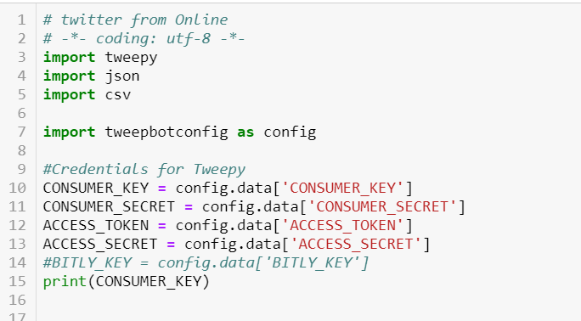
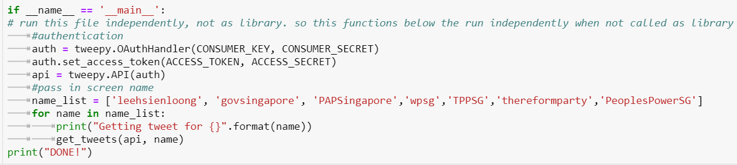
What are singaporeans thinking of?
Twitter Api
Called out posts from a few accounts that best represents Singapore’s voice

Slide 6
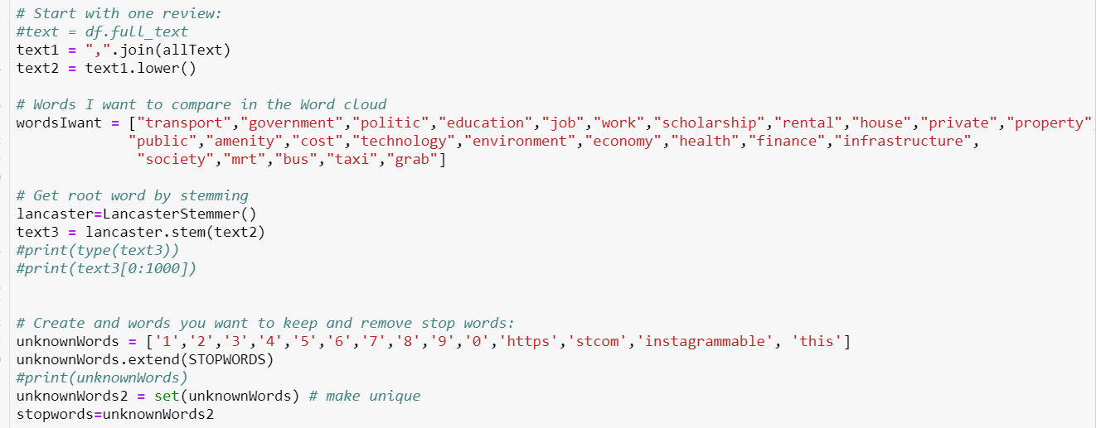
What are singaporeans thinking of?
Join all the files to a list, and make all words lowercase so words that are the same will be read the same
Narrow down to some words that are critical. This is the corpus
Word Stemming
Remove Stopwords and adding non dictionary words to the list of Stopwords

Slide 7

What are singaporeans thinking of?
Analysis : Transport , Mrt are one of the quite common words used, hence they are not insignificant to study

Slide 8
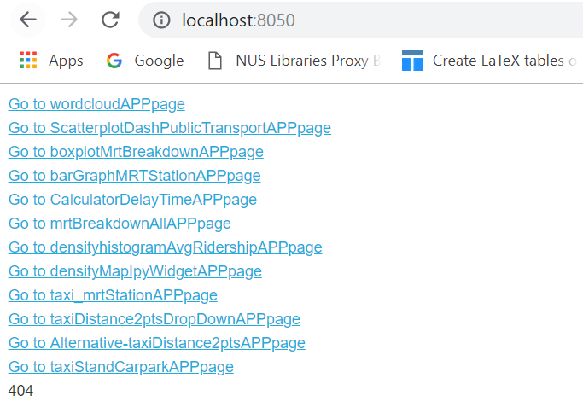
How to use my Web APP
Look for index.py file that is used as an entry point to run all the apps together in web( a total of 12 py files)
Run this file on console
On chrome, type localhost:8050 to run your web app.
I used localhost since all my data are in my local computer and MySQL and MongoDB

Slide 9
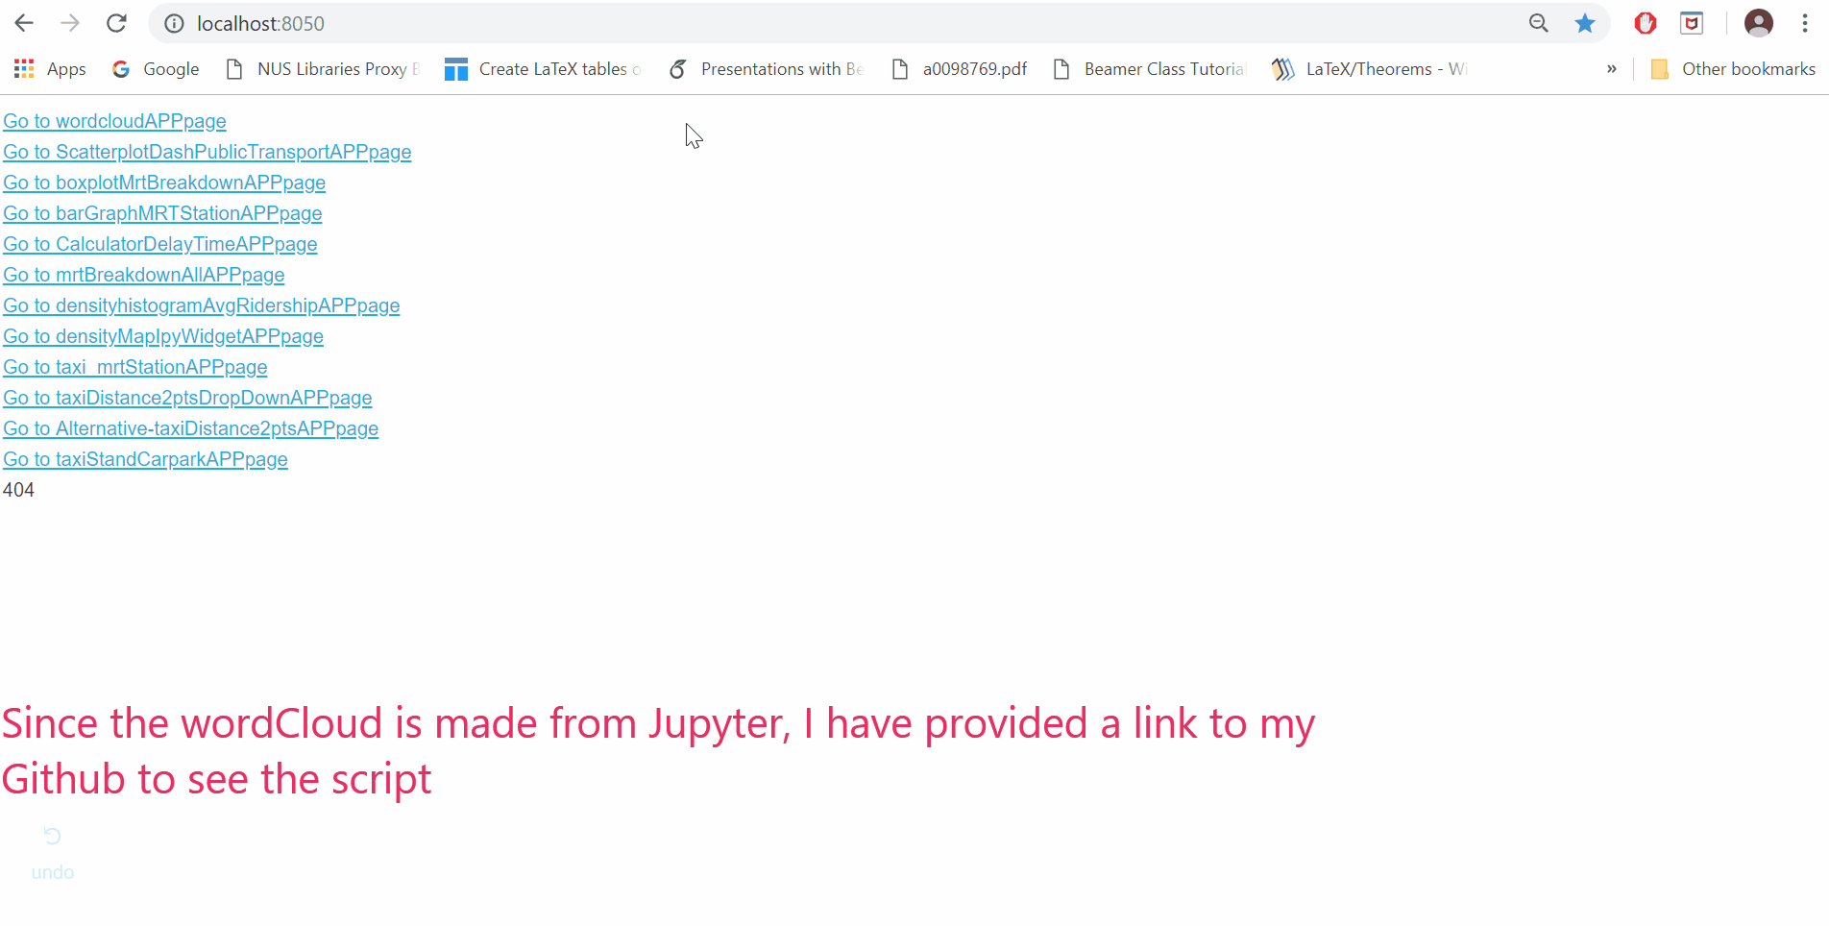
What are singaporeans thinking of?
See it in action on Web App created using Dash. The codes for the word cloud is done in Jupyter, so I had put the link to my script on server.

Slide 10
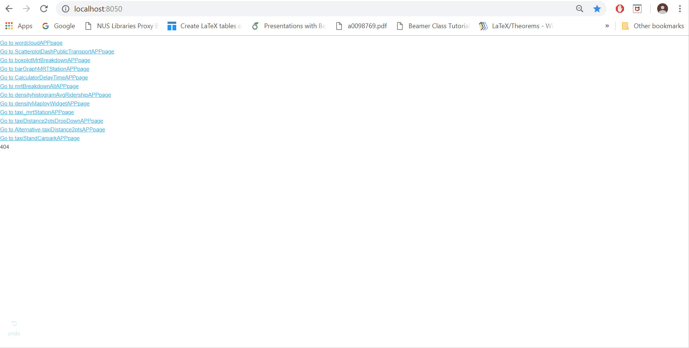
ScatterPlot of Average Trip distance by Public Transports
Top 2:
Taxi and Mrt In distance travelled per trip.
Hence good to talk about them

Slide 11
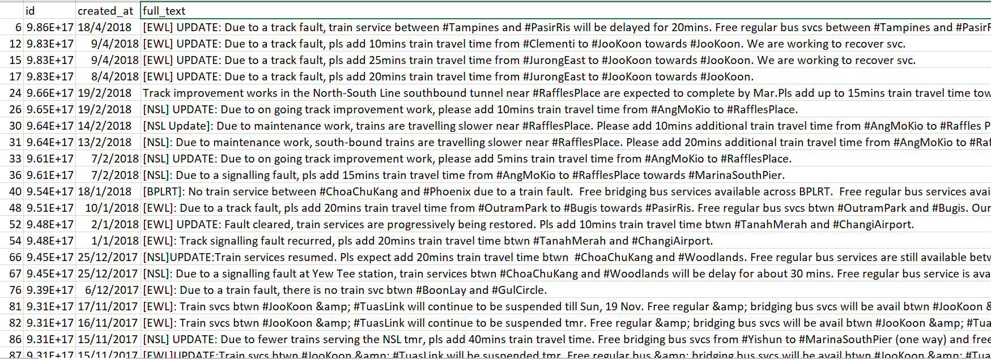
MRT: Frequency of MRT breakdowns Sep 2012 - Apr 2018
Tweets taken from Twitter API to be manually cleaned and then tabulated and calculate frequency of MRT breakdowns

Slide 12
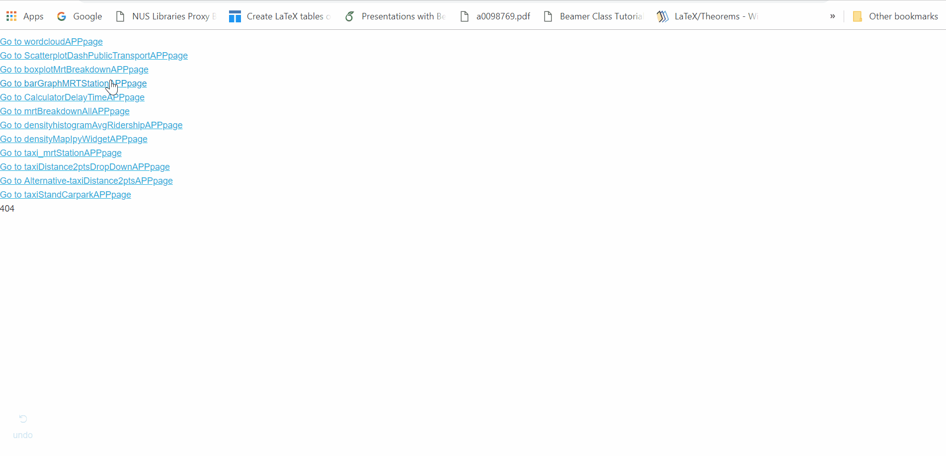
Boxplot of MRT: Frequency of MRT breakdowns Sep 2012 - Apr 2018
NSL has most number of breakdowns.
NEL has least breakdowns even though it is not the newest train line

Slide 13
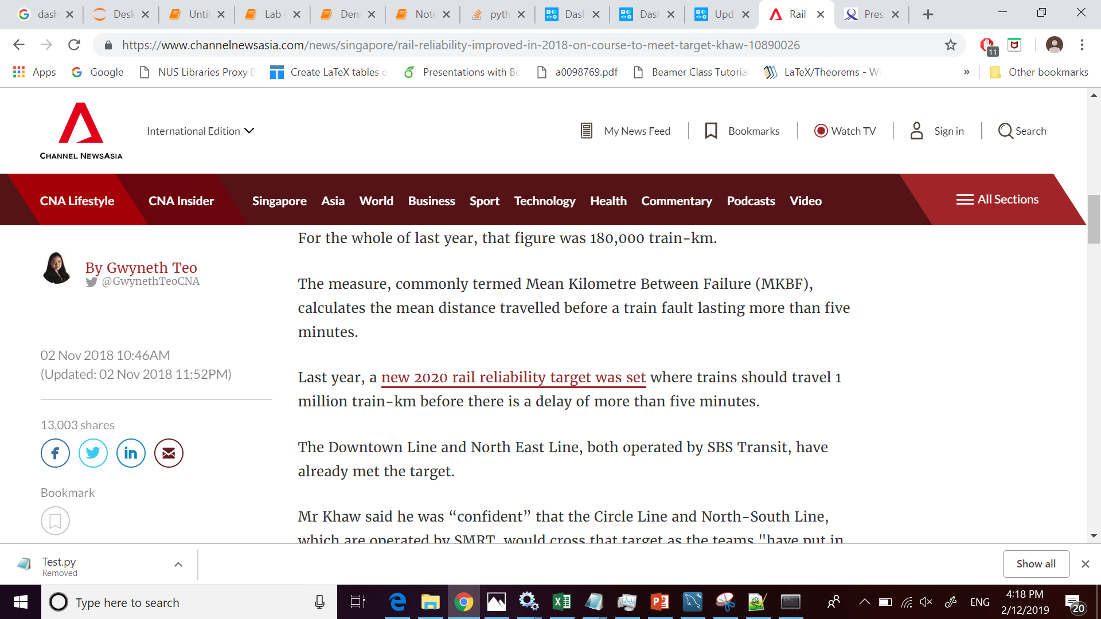
Supporting news: NEL and DTL most reliable

Slide 14
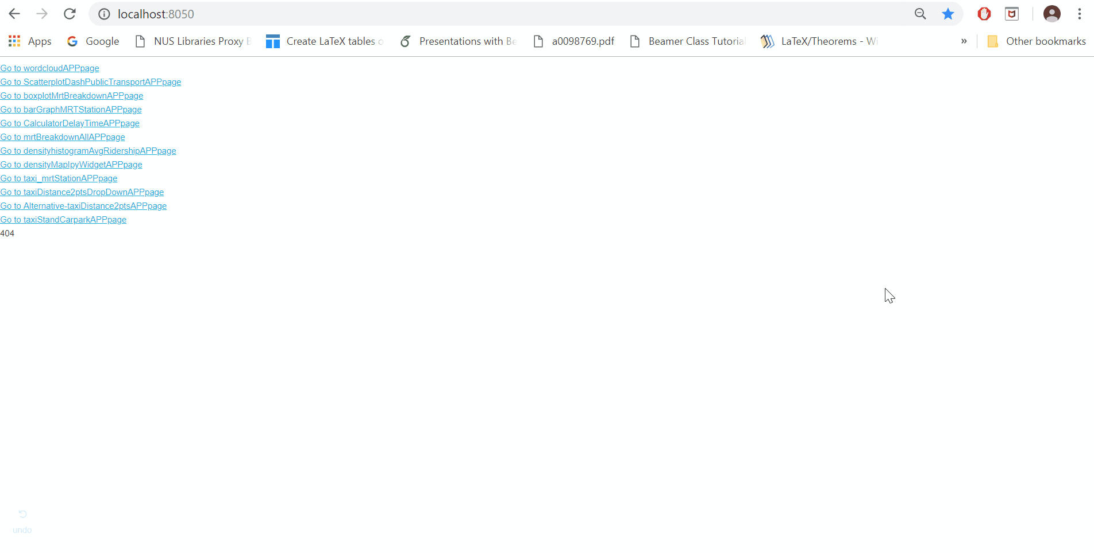
Bar Graph of MRT breakdown fr Sep 2012 - Apr 2018 Normalised by MRT Line
Purpose of this graph is to see the proportion of which MRT station fairs better in performance in comparison to its own Line. This is fair since some MRT rails are older than others.
There are multiple Tabs

Slide 15
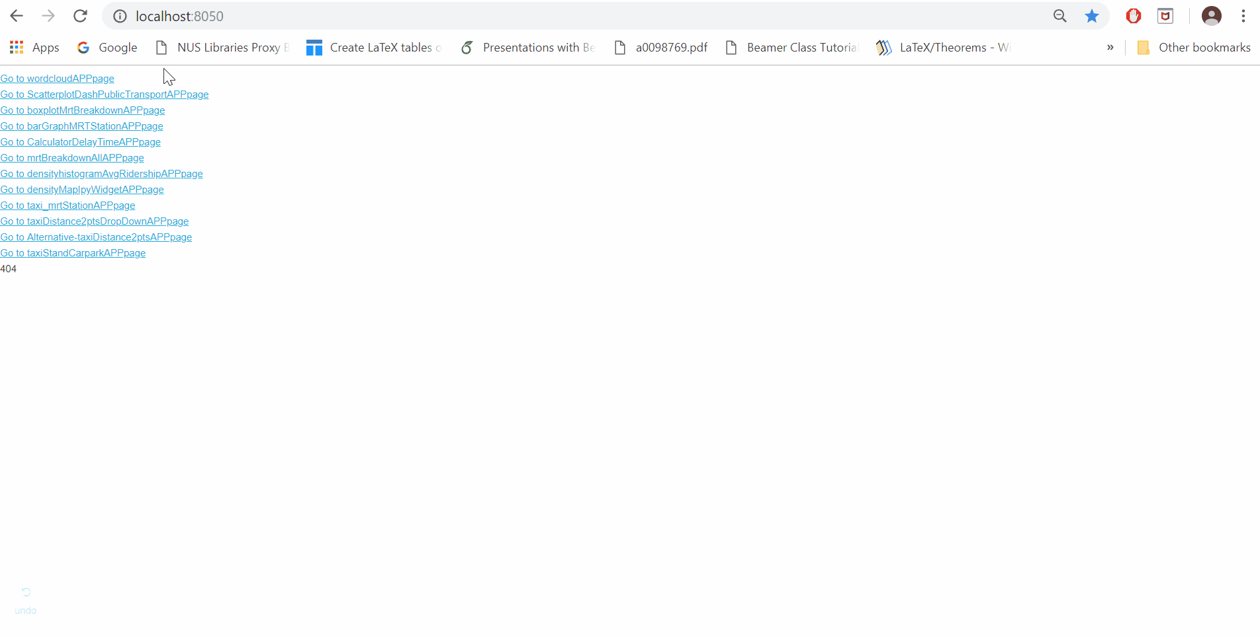
MRT Calculator: Percentage of MRT delay occurence based on Sep 2012 - Apr 2018 data

Slide 16
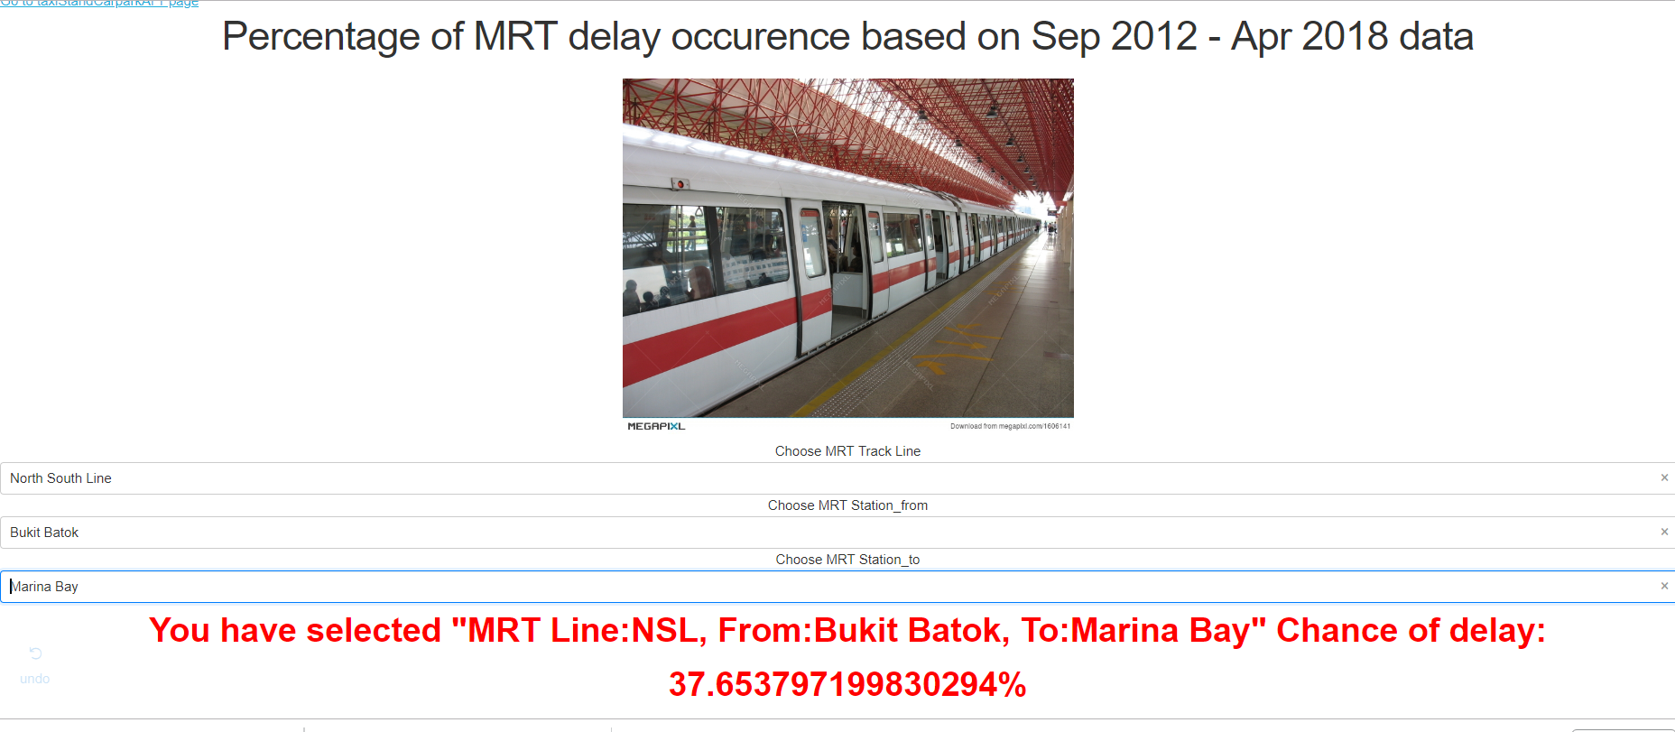
MRT Calculator: Percentage of MRT delay occurence based on Sep 2012 - Apr 2018 data

Slide 17
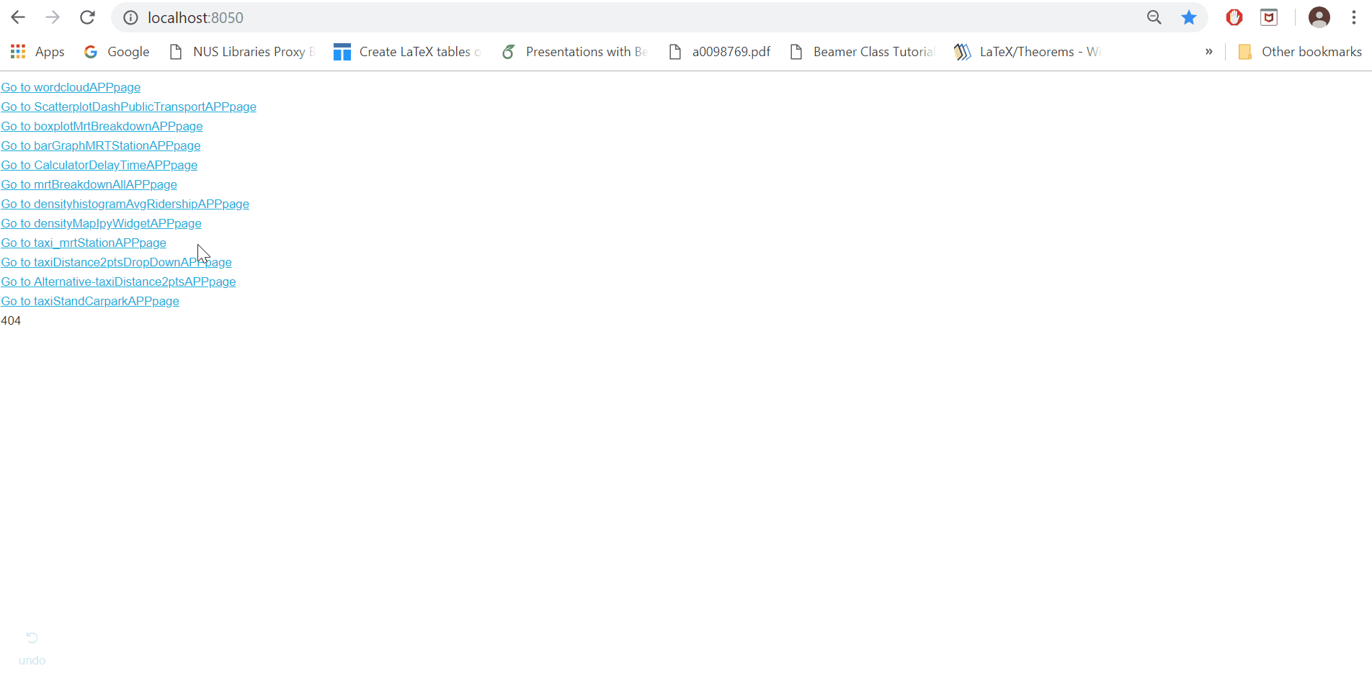
BUBBLE CHART: MRT breakdown Overview from Sep 2012 - Apr 2018
Using the Twitter Api data , the BubbleChart is constructed with a slider for user to see which MRT stations have what probability of breakdown on a spatial view.
Dash also allows for selection of which MRT line to be shown
As shown, Bubble on NSL appears largest

Slide 18
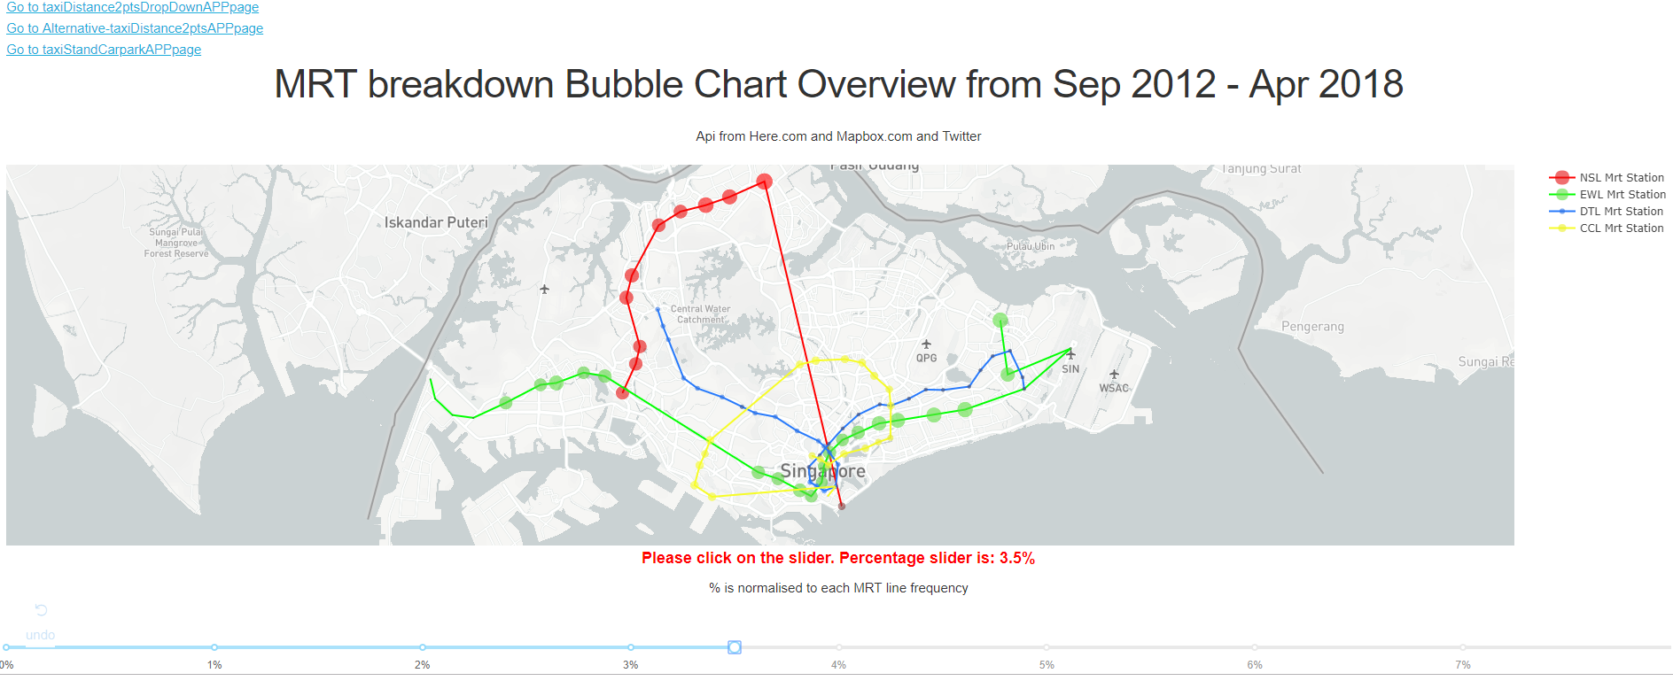
BUBBLE CHART: MRT breakdown Overview from Sep 2012 - Apr 2018

Slide 19
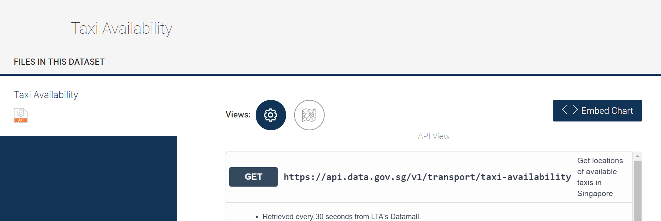
TAXI: TAXI availability
Taxi API from data.gov.sg. Data collected from 24Jan 2344 to 28Jan 2359 every minute

Slide 20
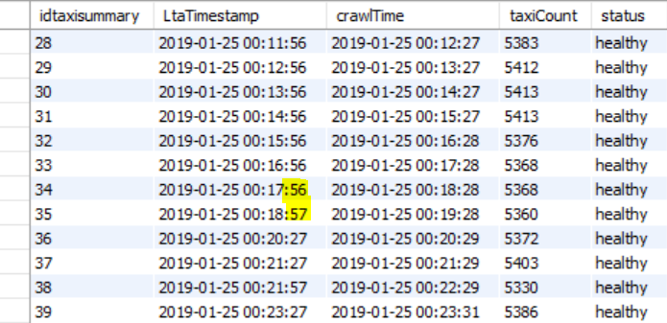
TAXI: TAXI availability API
Evidence suggests that LTA data does not come in every same minute mark. This is because of small milliseconds of time it takes to fetch API data from LTA side

Slide 21
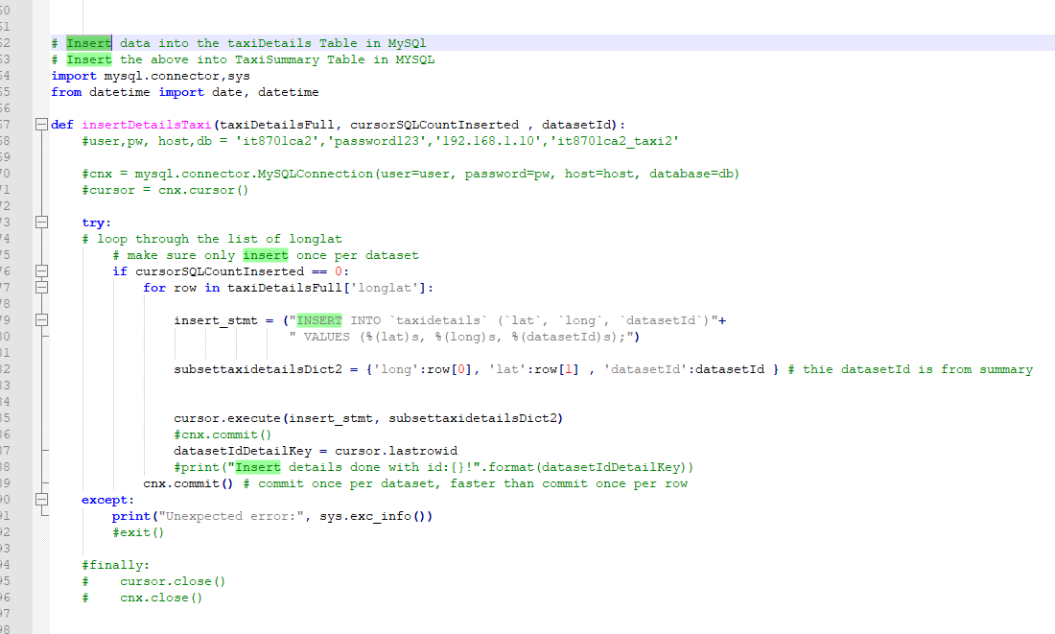
Taxi availability DB no repeat data input for timestamp
This is only part of the full code.
This function ensures that input into the Taxi summary data base is always with a unique LtaTimestamp so the data row is not repeated.

Slide 22
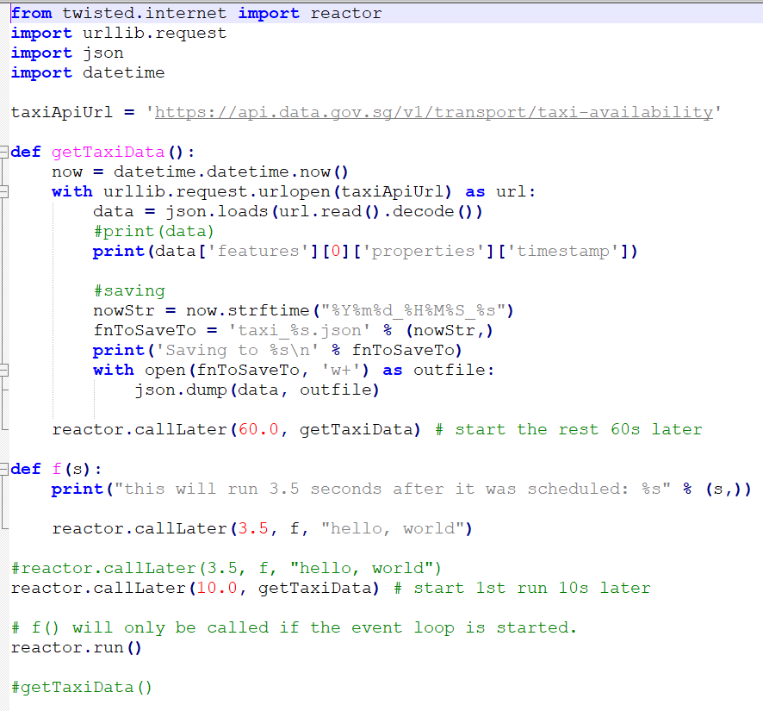
TAXI: TAXI availability
Scheduler for retrieving Data API every minute
First run is wait 10sec then call the getTaxiData(). There after, call the script 60 sec after end of each run (may take small time to fetch data). Data API also release the data the same way, not 60 sec from start to another start of fetching.

Slide 23
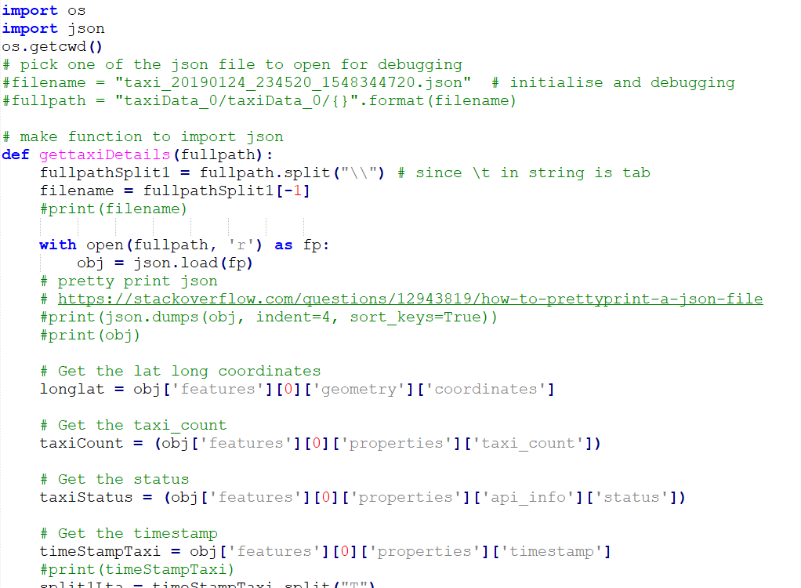
TAXI: TAXI availability
The data collected from API is in json form. Draw out relevant fields and insert into database
Note that commit done per json file instead of per line to quicken the speed of inserting data.

Slide 24
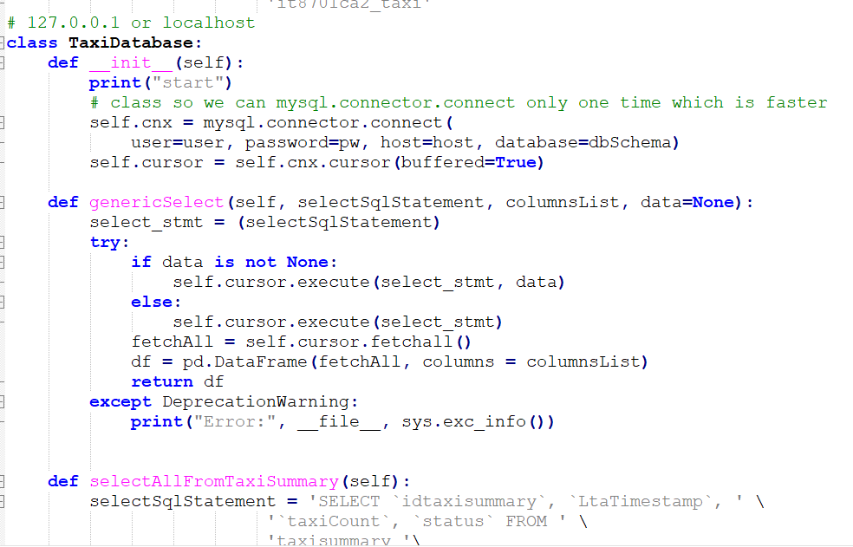
Taxi availability
To retrieve the 21.2 millions rows of data into MySQL , use class structure so I don’t have to reconnect and disconnect each function from MySQL , as it may delay data retrieval.

Slide 25
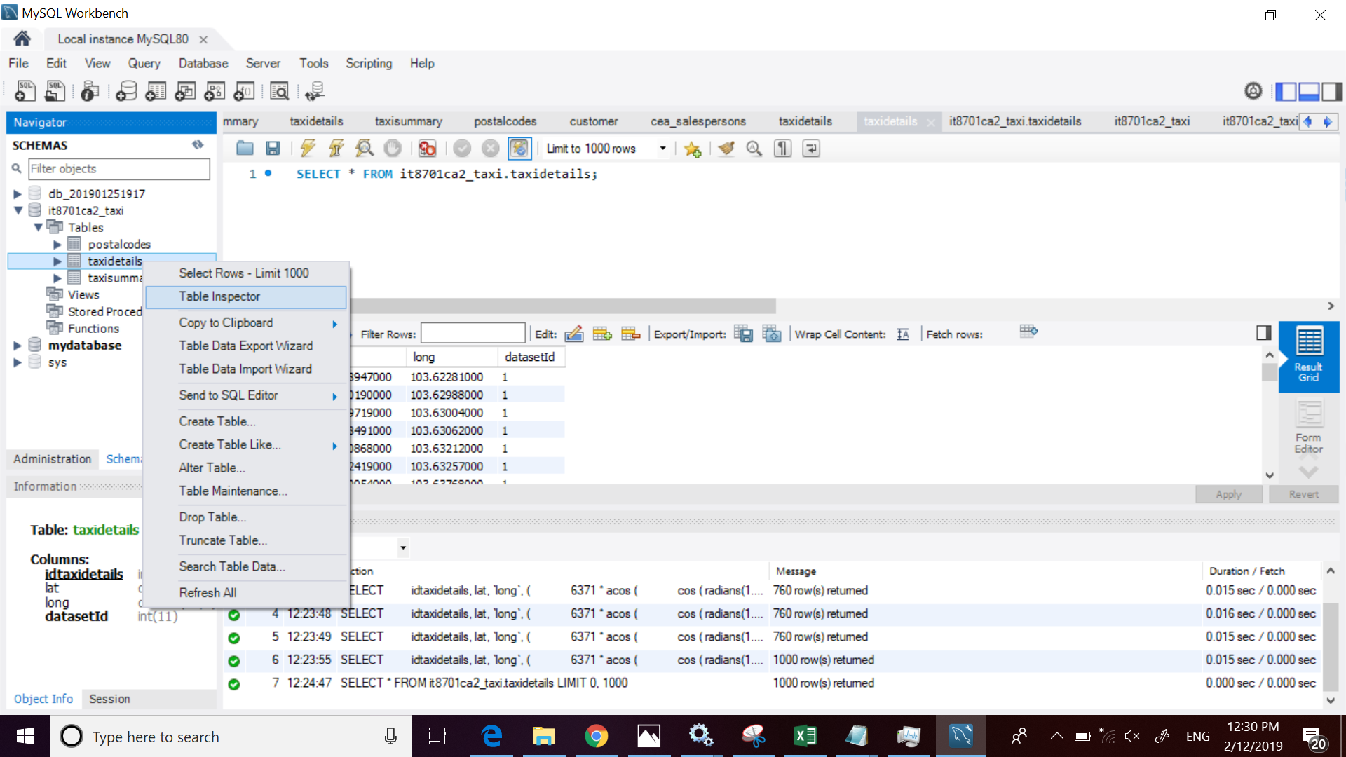
Taxi availability : Database improvement

Slide 26
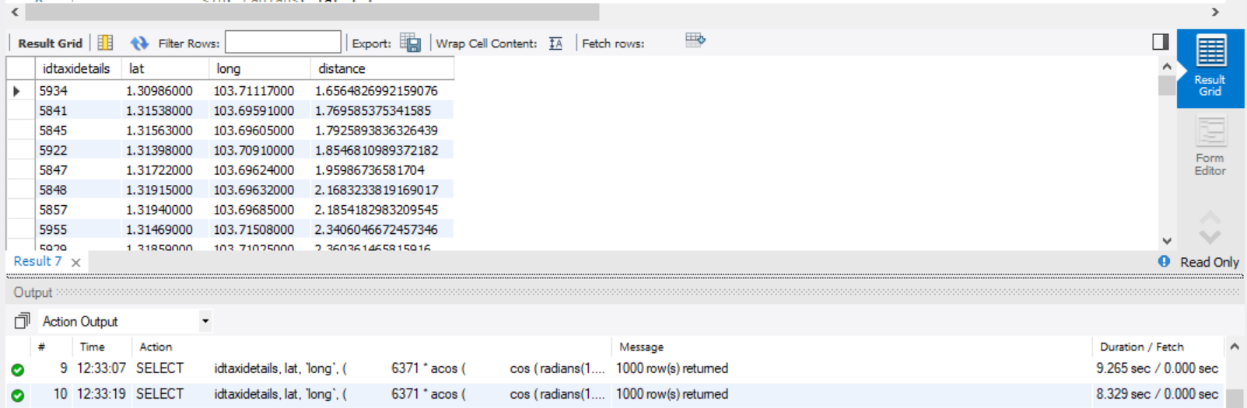
Taxi availability : Database improvement
Before index adjustment, each hover on the Map (to be shown later) takes 9 sec to select nearest taxis within 2 km from a hover point

Slide 27
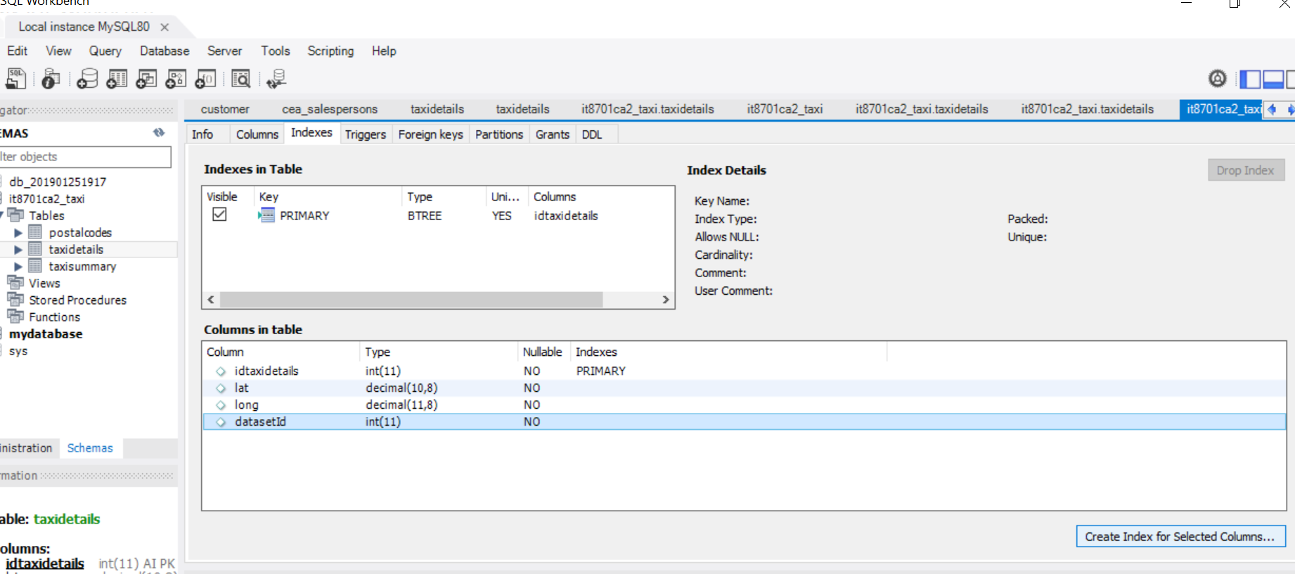
Taxi availability : Database improvement

Slide 28
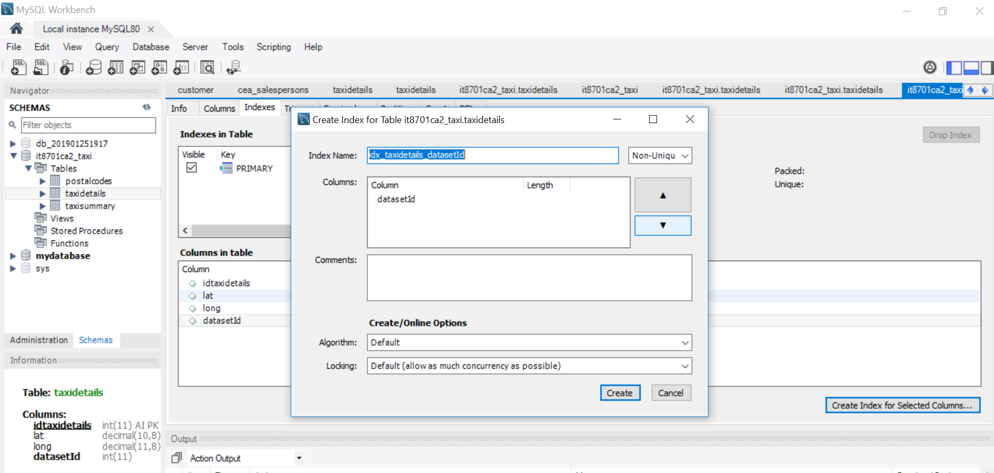
Taxi availability : Database improvement

Slide 29
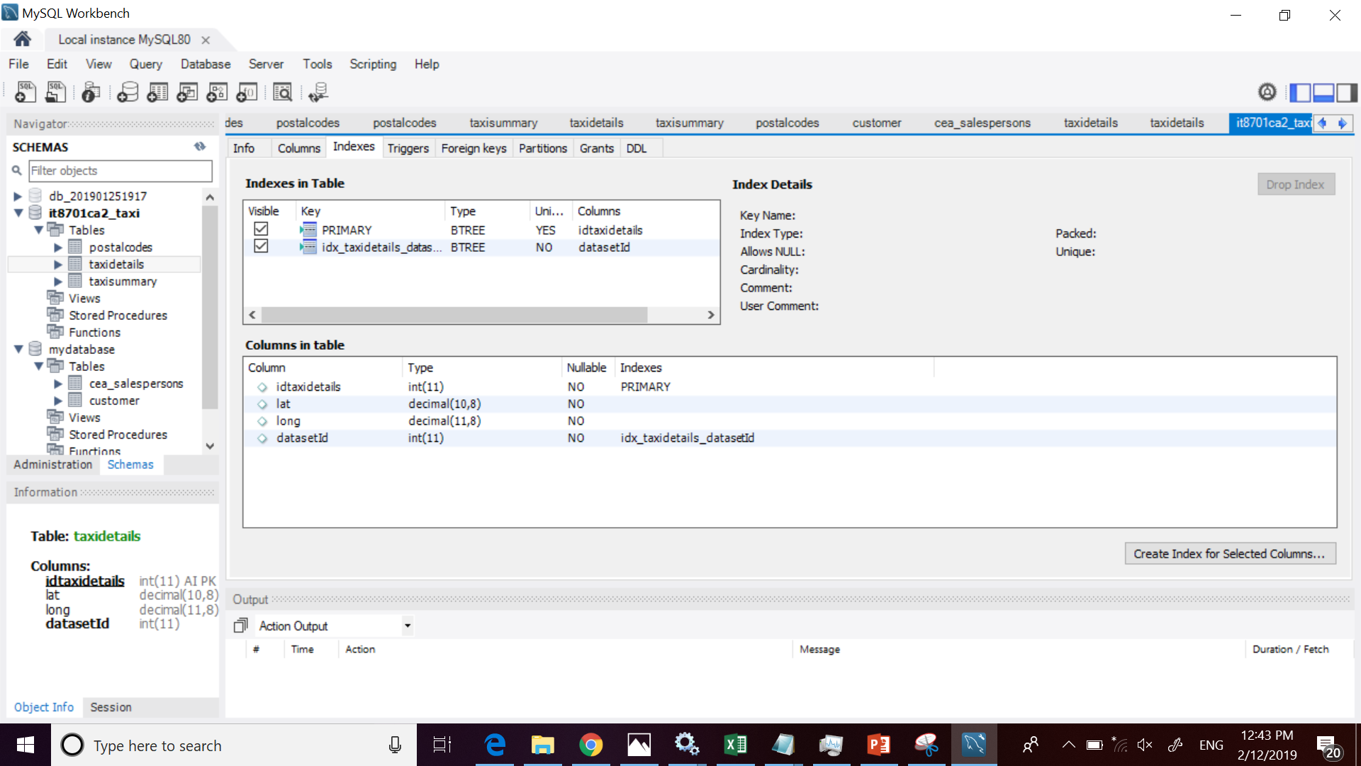
Taxi availability : Database improvement
This will set the second index and make the whole data retrieval for taxi availability within 2km faster

Slide 30
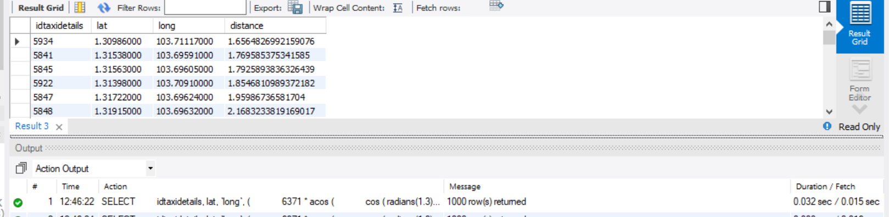
Taxi availability : Database improvement
Now so much faster!

Slide 31
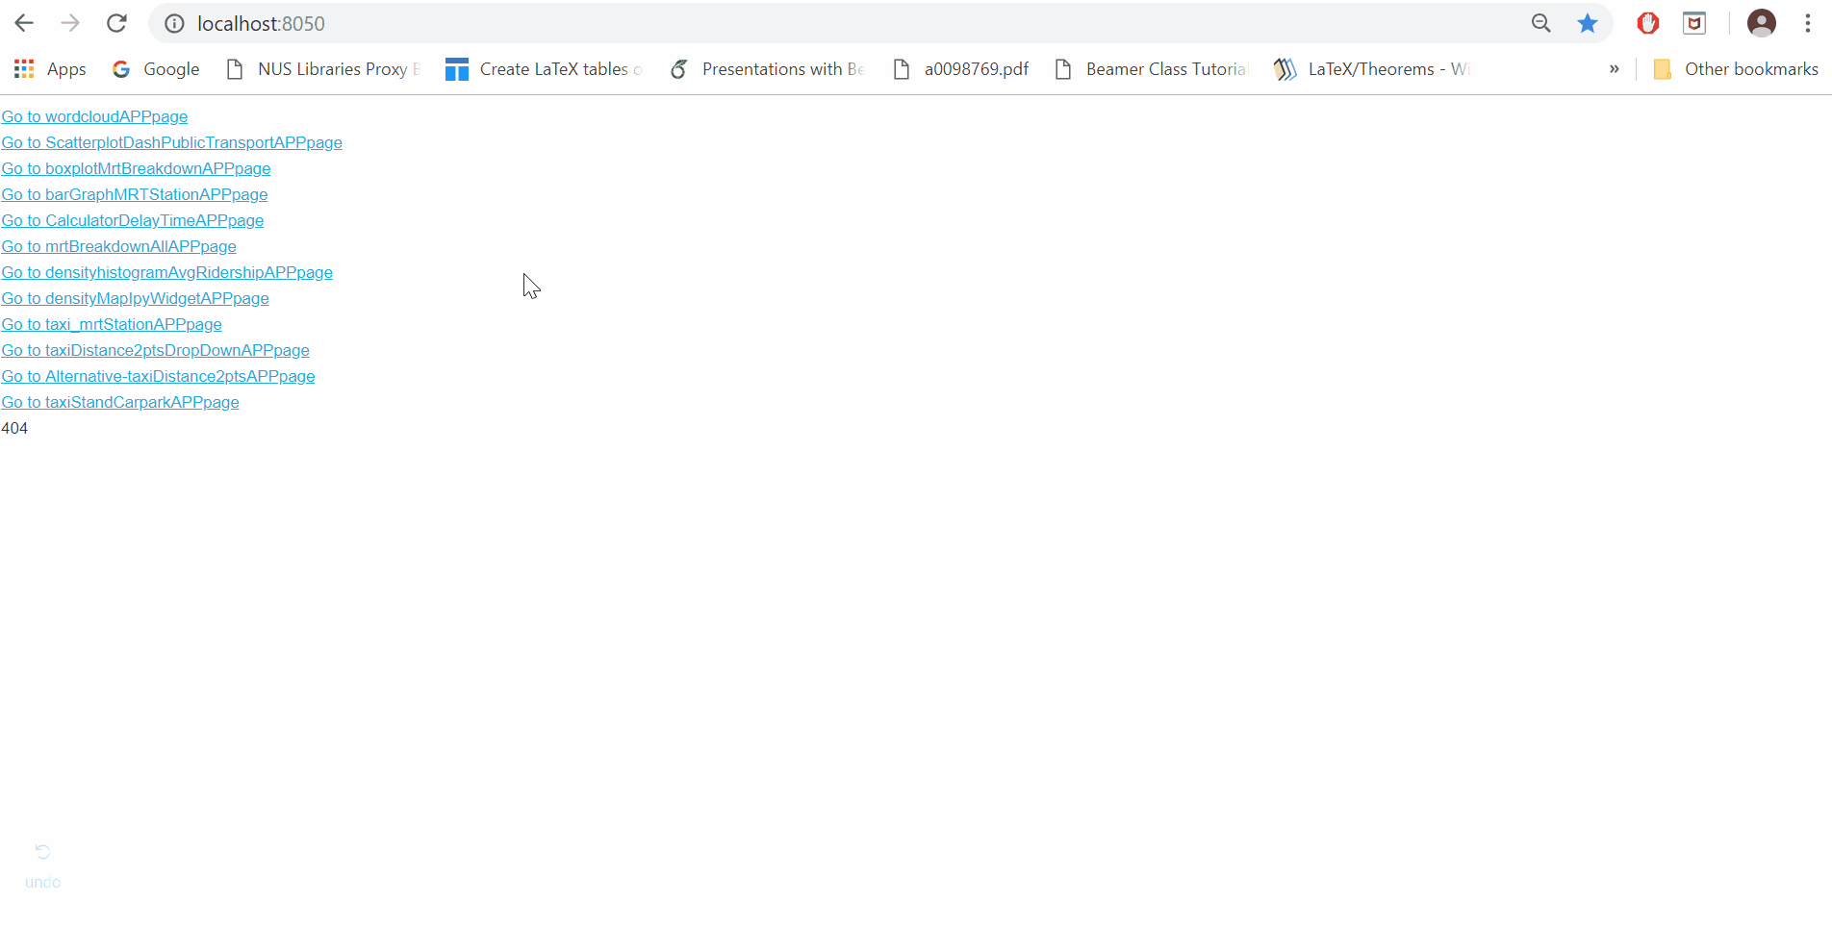
Histogram Density : Taxi availability
Histogram cum Density map is plotted. Lat is vertical axis while Long is horizontal axis.
Slider allows user to see the distribution of taxis across time.
Analysis: Taxis are mostly centralized in Changi airport and Central regions

Slide 32
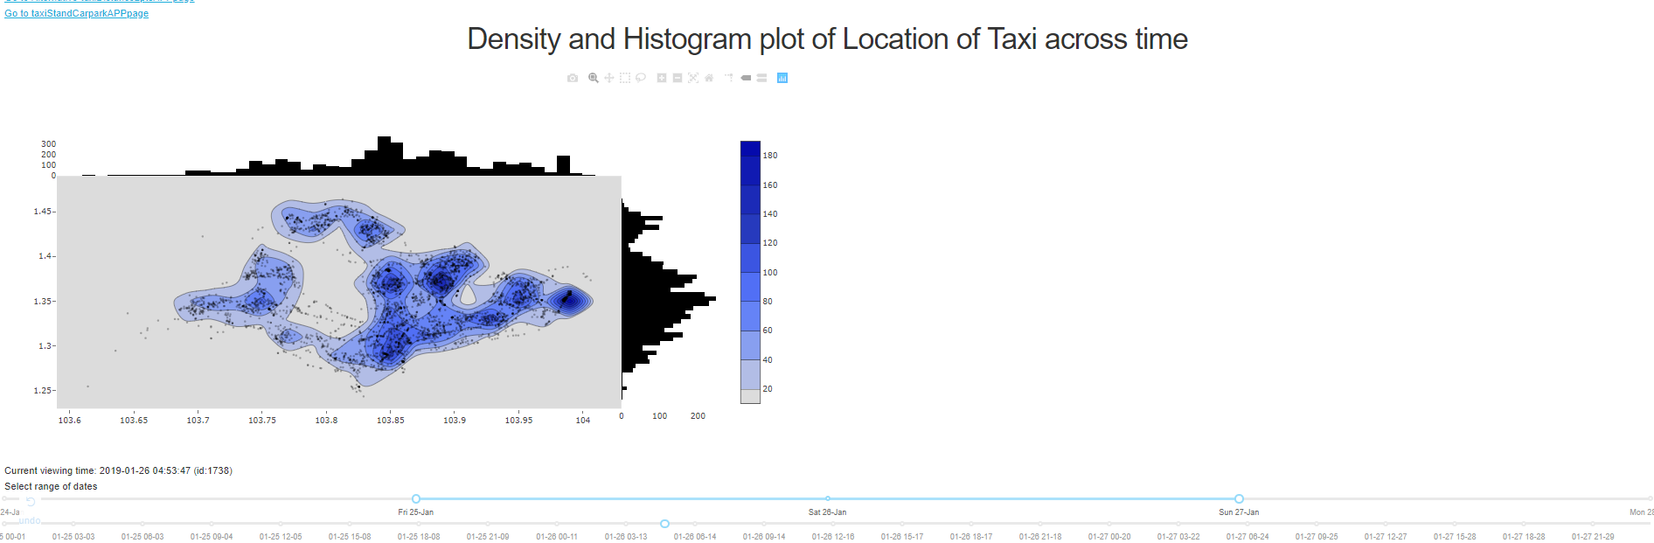
Histogram Density : Taxi availability

Slide 33
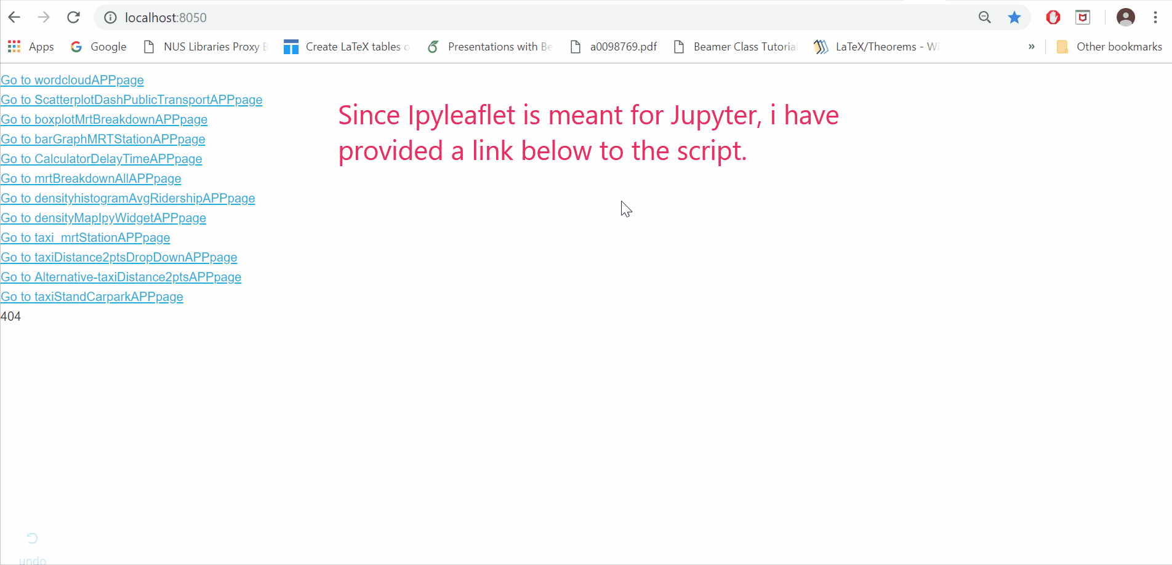
Density Map done with Ipyleaflet for TAXi
Done with Ipyleaflet, so user have to see the graph in action with Jupyter. This gives a better visual representation
Graph also provides details like Datetime, Total Taxis, and Datasetid
Analysis same as previous slide

Slide 34
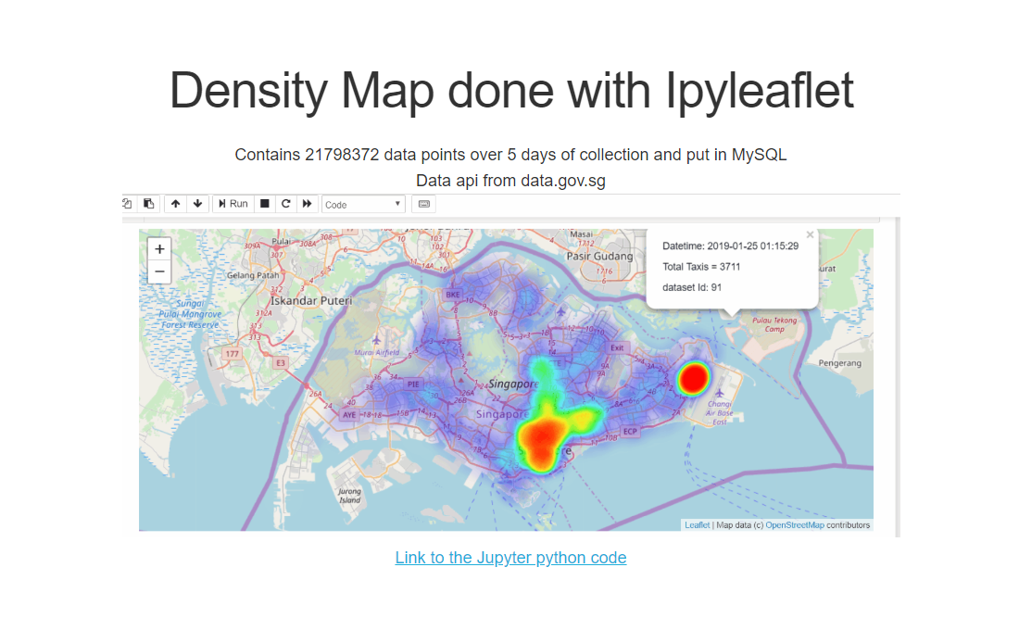
Density Map done with Ipyleaflet for TAXi
Link to full script

Slide 35
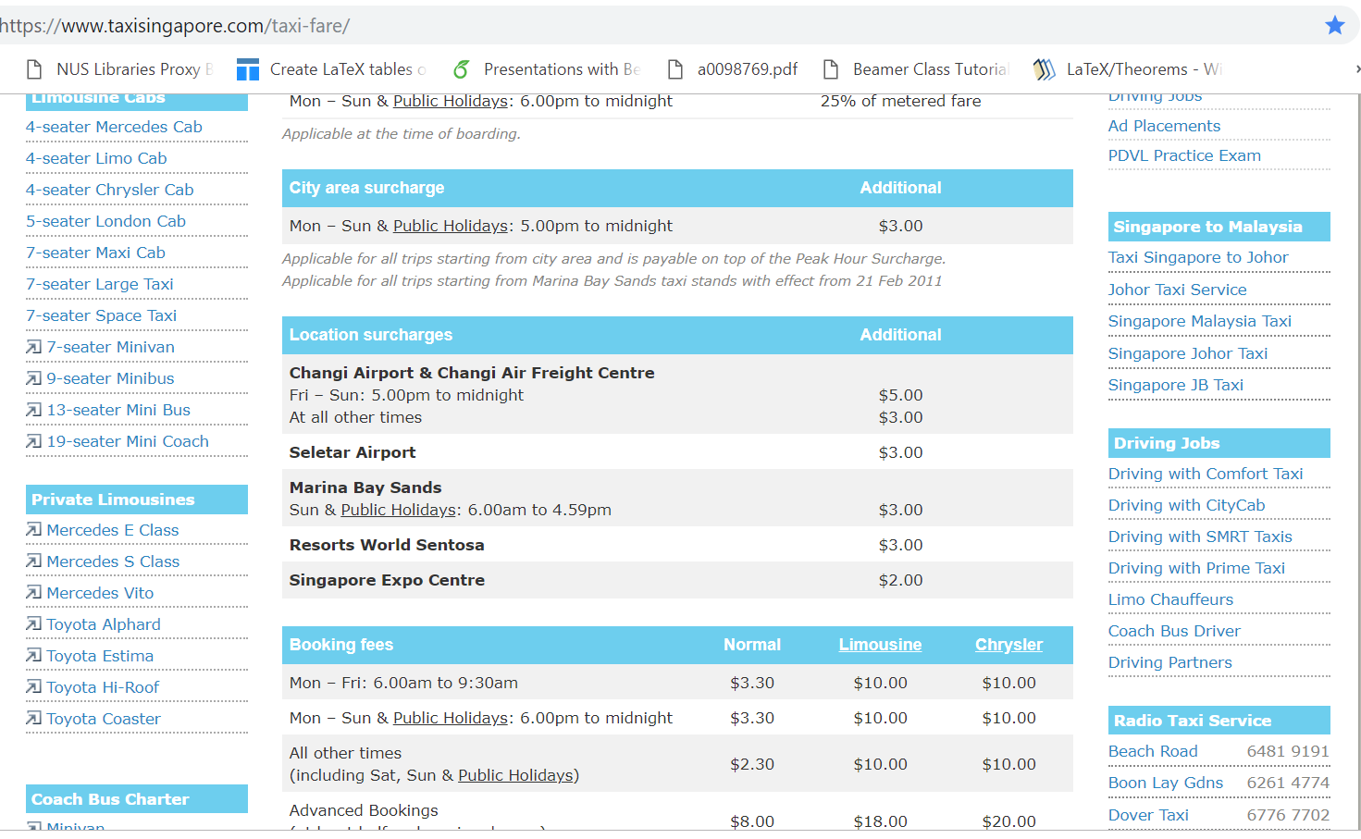
Supporting: Changi and town has more taxi availability

Slide 36
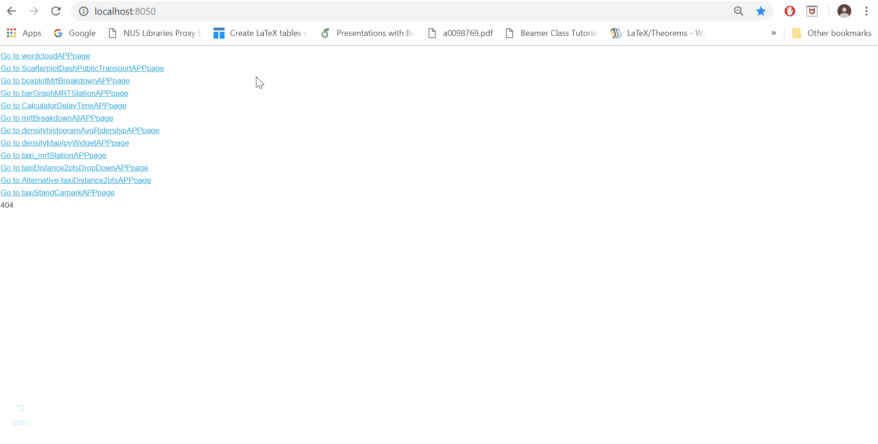
ScatterMap: Number of Taxi within 2km of where you are
Hover to any of the MRT station(marker for this app)
Scattermap of taxis around the pointer will be shown
Use rangeslider and slider to change datetime
Output will show user how many near by taxis within 2km

Slide 37
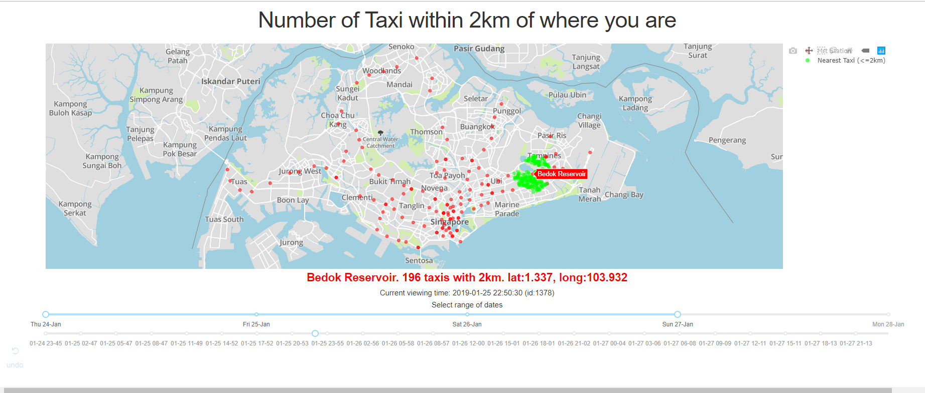
ScatterMap: Number of Taxi within 2km of where you are

Slide 38
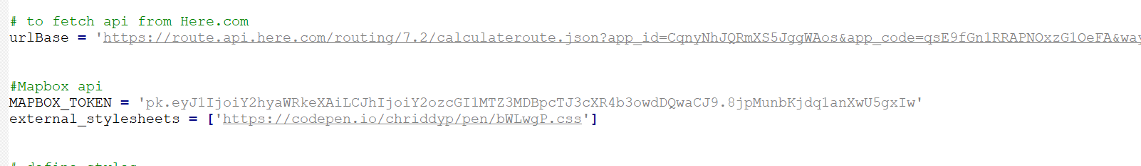
TAXI: Shortest travelling distance between any 2 locations
Data from Here.com API and Mapbox API. It will give us the shortest route (potentially also time) for any 2 points. It will give slight different results from Google map. Did not use Google Maps because it is a chargeable API (free for a limited usage only).

Slide 39
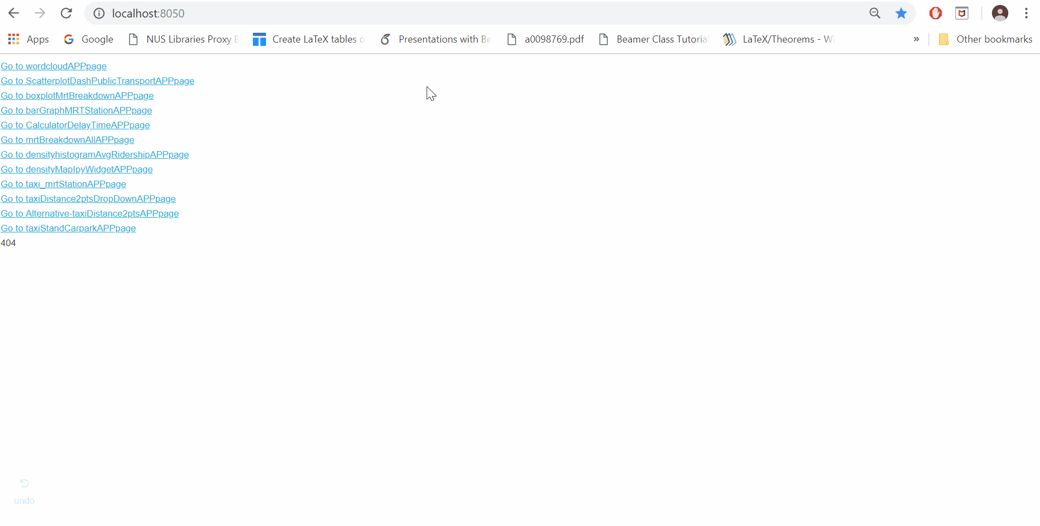
TAXI: Shortest travelling distance between any 2 locations
This app uses Dash Dropdown menu outputs:
Distance and time travelled
Note that I used a subset of buildings postal code here because it hangs my Chrome. For full set of postal data, please refer to ‘Concat_Add_PostalCode_distbtw2Pts.csv’

Slide 40
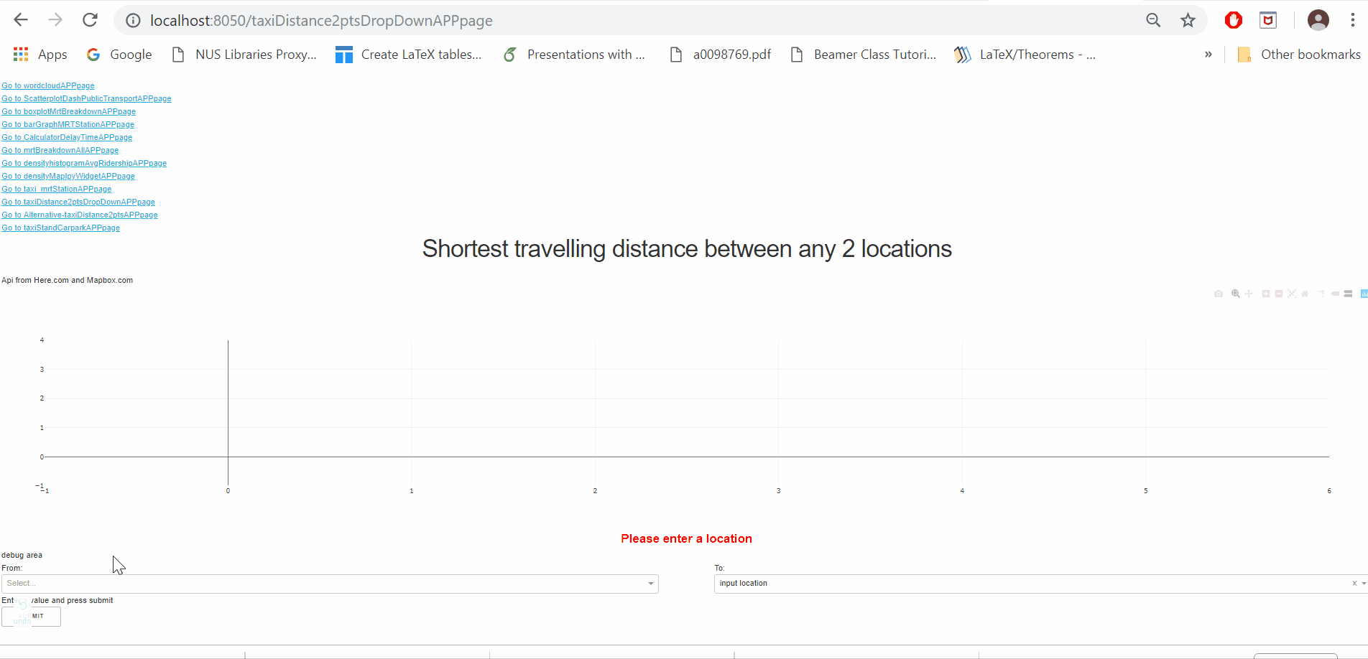
TAXI: Shortest travelling distance between any 2 locations can do REgex

Slide 41
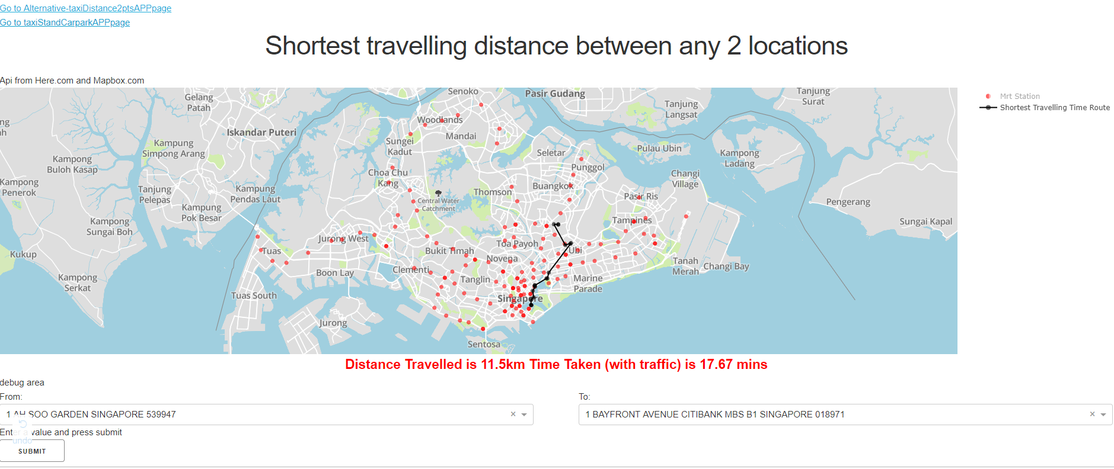
TAXI: Shortest travelling distance between any 2 locations
Here.com and Mapbox.com API are drawn live, so some of the output is slightly diff each time we run the same 2 locations
User can also type partial address and this dropdown can text complete

Slide 42
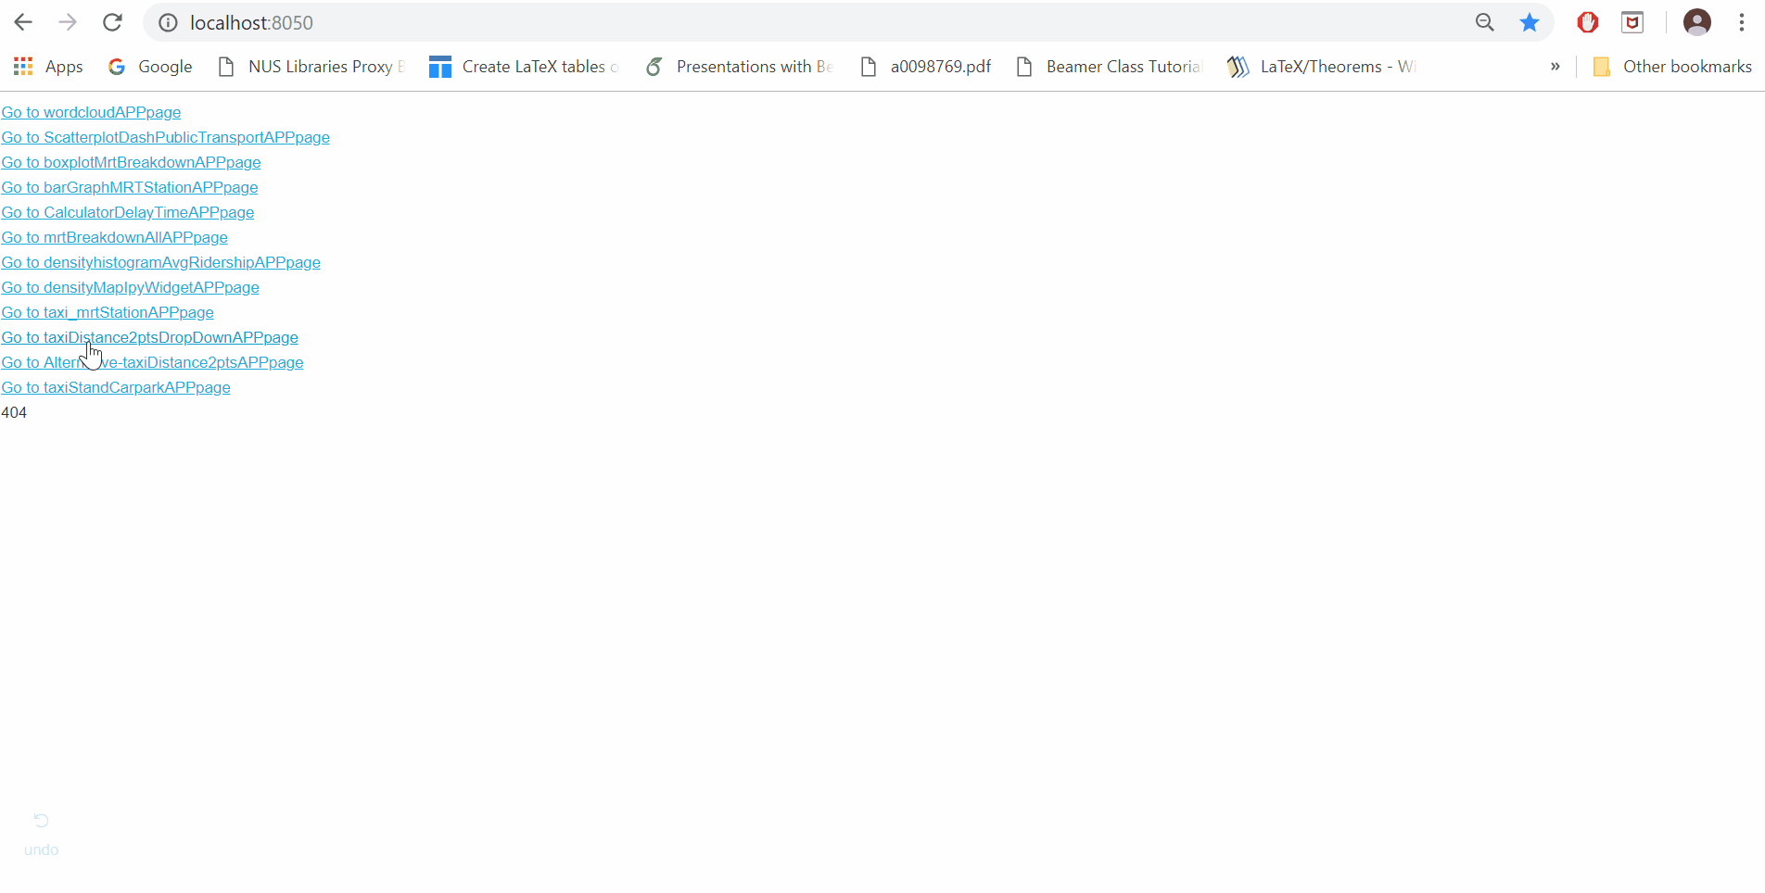
Taxi: Shortest travelling distance between any 2 locations
This app is similar to previous one except that this uses Dash textbox
Advantage is it is faster because we do not have to load all the addresses into Chrome. This only searches from MySQL and do not need to load data before we type the text.

Slide 43
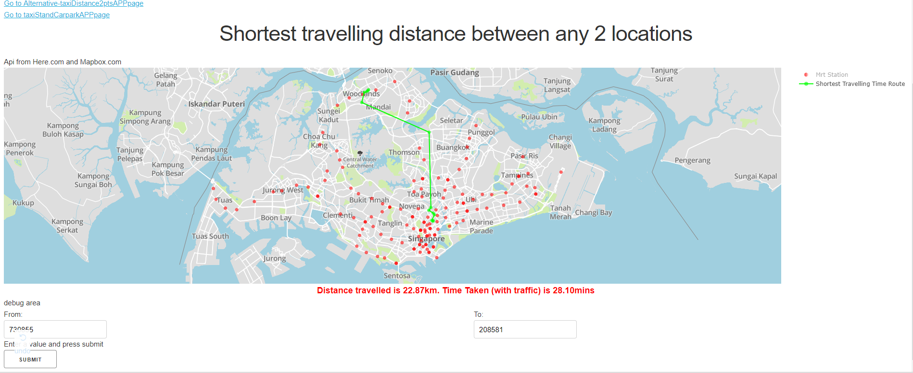
Taxi: Shortest travelling distance between any 2 locations

Slide 44
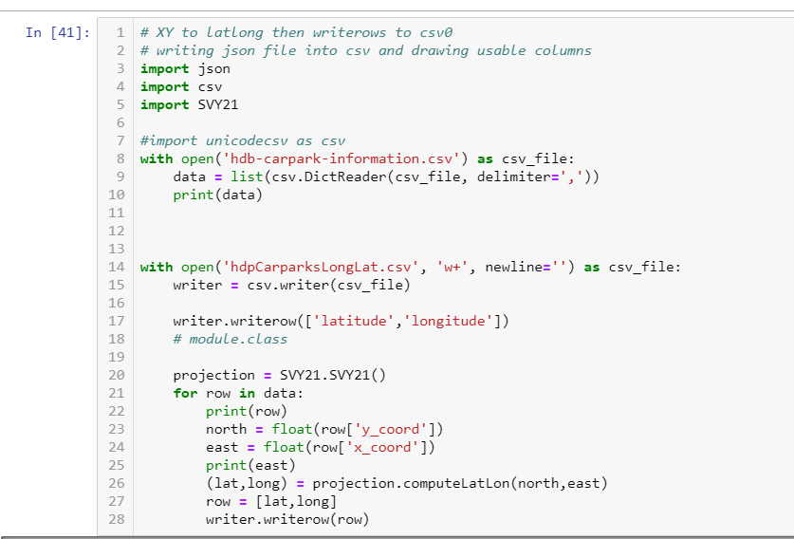
Data wrangling for XY coordinates to Lat Long CARPark locations
In particular, the HDB carpark
Positions are given in XY coodinates
so we have to wrangle the data to
transform it to Latitude and Longitude
for use in my Mapbox tool

Slide 45
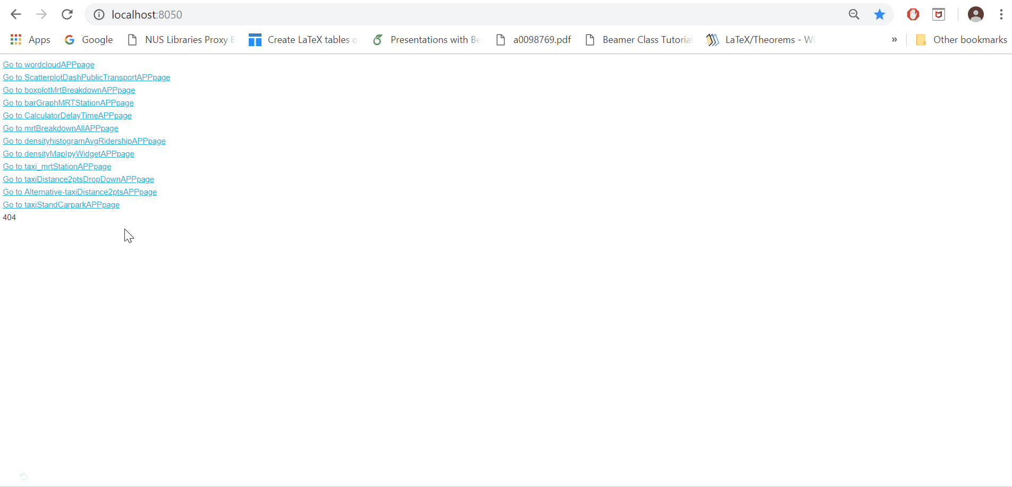
ScatterMAP and Line Graph with Carparks: Where are the Taxi's Hidding?
Includes Map and time series, controlled by Rangeslider, slider and timeseries slider

Slide 46
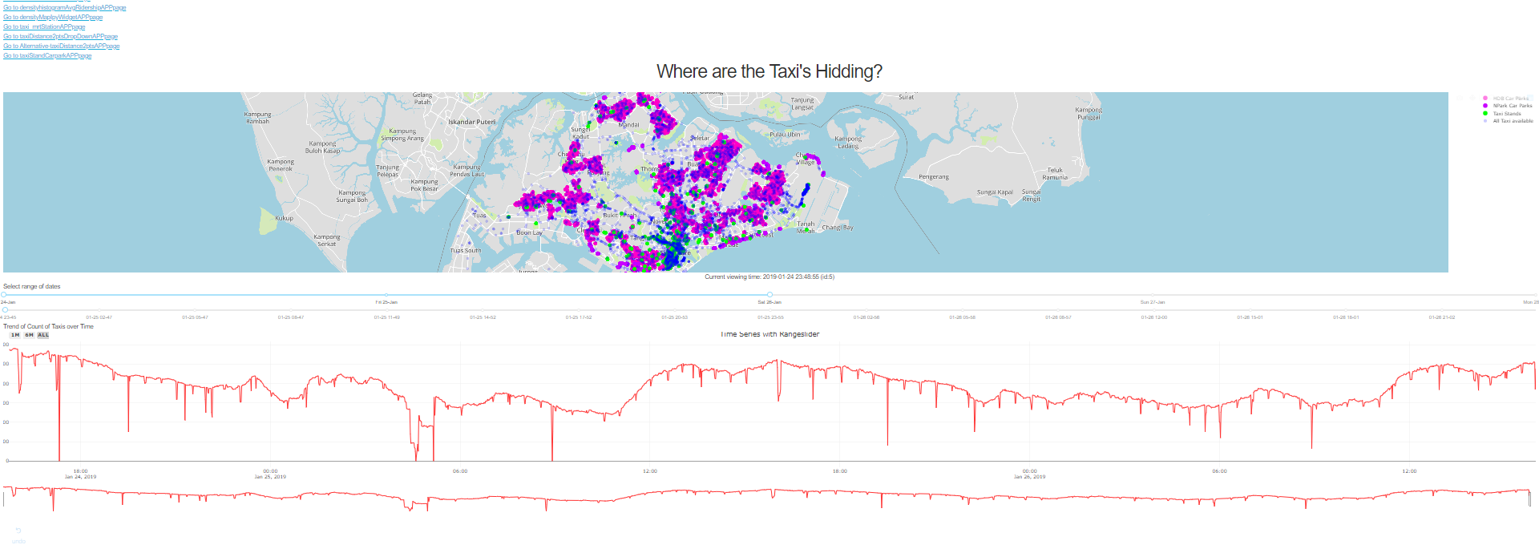
ScatterMAP and line graph with Carparks: Where are the Taxi's Hidding?

Slide 47
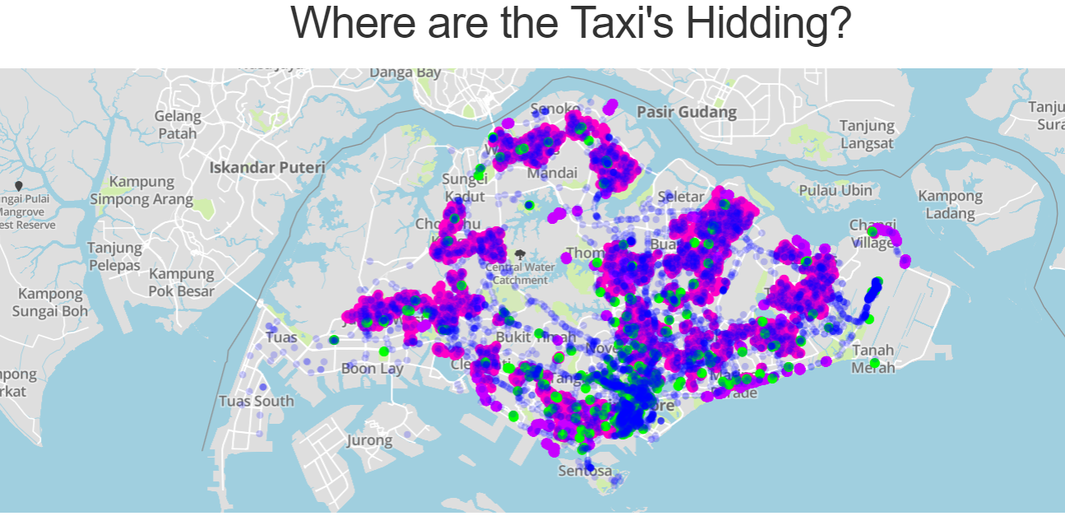
ScatterMAP with Carparks and TaxiStands: Where are the Taxi's Hidding?
From far it appears that the taxis are hiding near the carparks.
Users can also unselect some carparks and taxi stands from the graph(at legend)
There is a rangeslider for date and slider for time
There is a Timeseries that is linked to the rangeslider (See next slide)

Slide 48
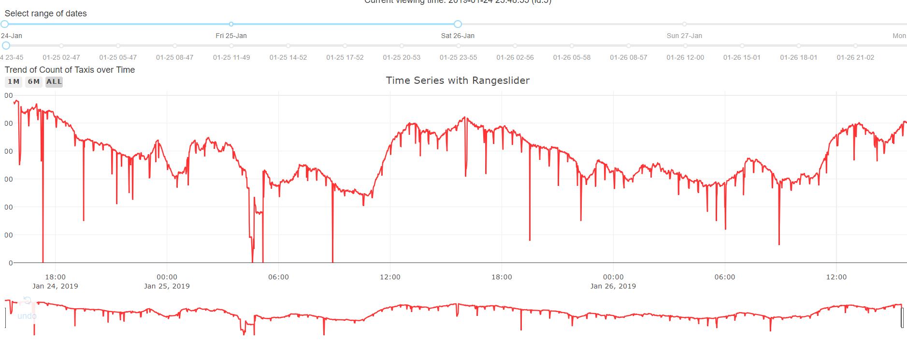
ScatterMAP with Carparks and TaxiStands: Where are the Taxi's Hidding?
The Timeseries range is determined by the dash rangeslider.
We can ignore the sharp dips as they could be due to system error. We should focus on the main trend line.
There is a stagnant high availability in taxi before 12mn and the availability right after 12mn suddenly decreases quickly.
Opposite for 12nn

Slide 49
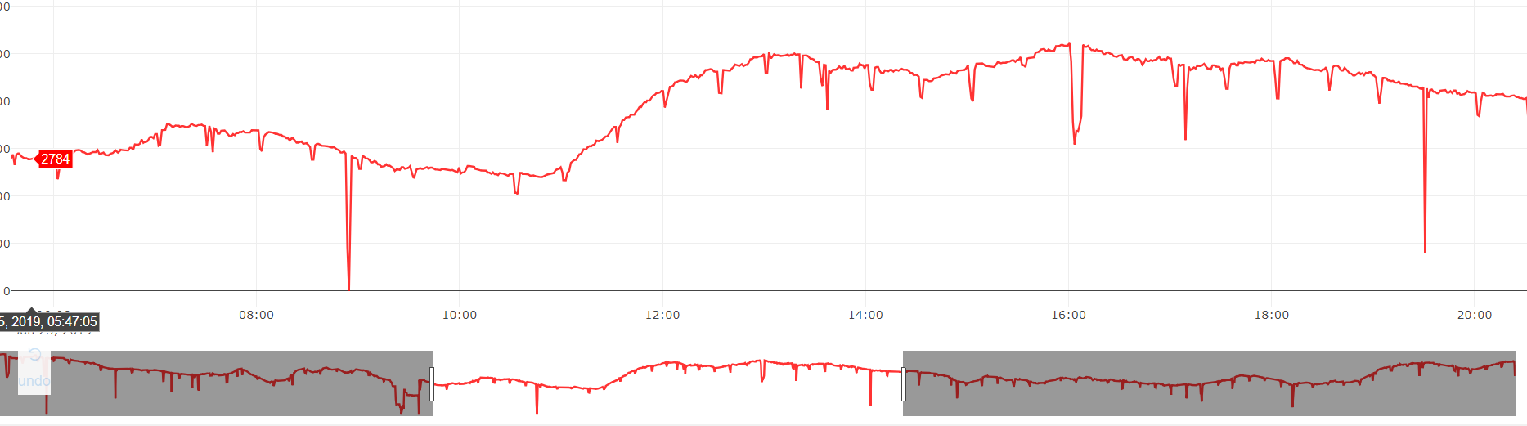
ScatterMAP with Carparks and TaxiStands: Where are the Taxi's Hidding?
Notice that we can further zoom in with the TimeSeries. The lower line graph can be further reduced so the larger graph zoom in for more details

Slide 50
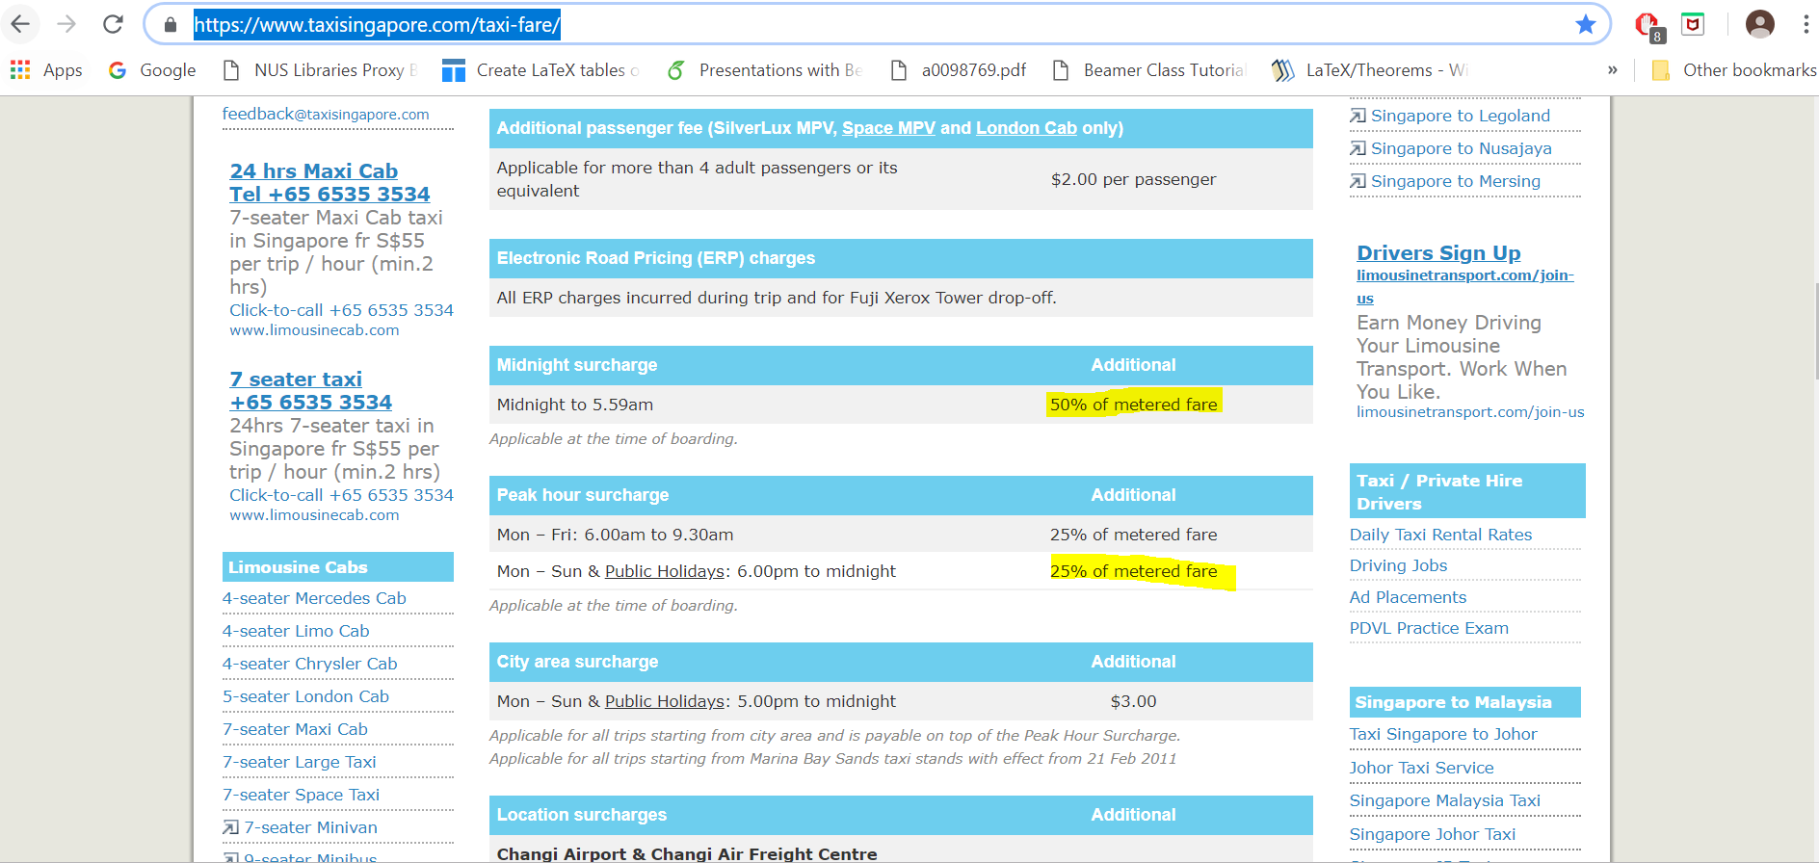
ScatterMAP with Carparks and TaxiStands: Where are the Taxi's Hidding?
Analysis: The drop in Taxi availability before 12nn could be due to the driver’s lunch time before the afternoon crowd comes out. After 12nn, the taxi availability increases
The trend for taxi at 12mn is confusing, until I see the website on the right (See picture)
When there is an additional surcharge (after 12mn), the taxis availability drops, but before that they are likely on hideout in carparks, etc
https://www.taxisingapore.com/taxi-fare/

Slide 51
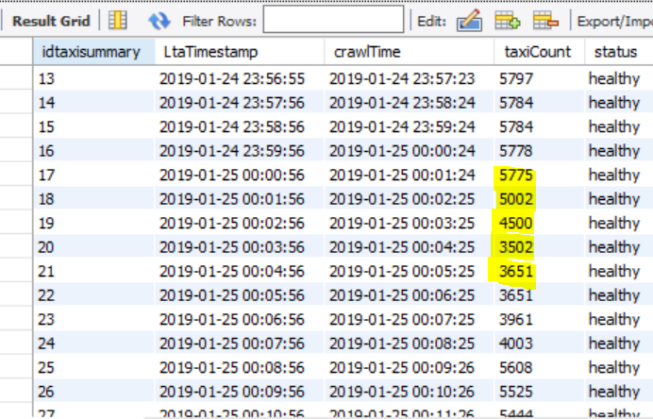
ScatterMAP with Carparks and TaxiStands: Where are the Taxi's Hidding?
This is evident in data collected. Before 12mn, the taxi availability is roughly stagnant at about 5.8k. ONLY 5mins after 12mn, it drops significantly to its lowest at 3651 taxis.
There are only 2 reasons
Taxi drivers go home/ closed meters
Taxi drives came out of hiding to pick up passengers

Slide 52
Conclusion
This project is mainly focusing on the Web App
For some of the apps, it helps users attain information like distance travelled.
Other apps gives insights on trends and help commuters make better transport decisions
All apps are made in DASH
MySQL, MongoDB and Pandas are used
Hope the project was meaningful and interesting! Do see the gifs in action to see how I used them!
Big THANK YOU!

